Slide 1
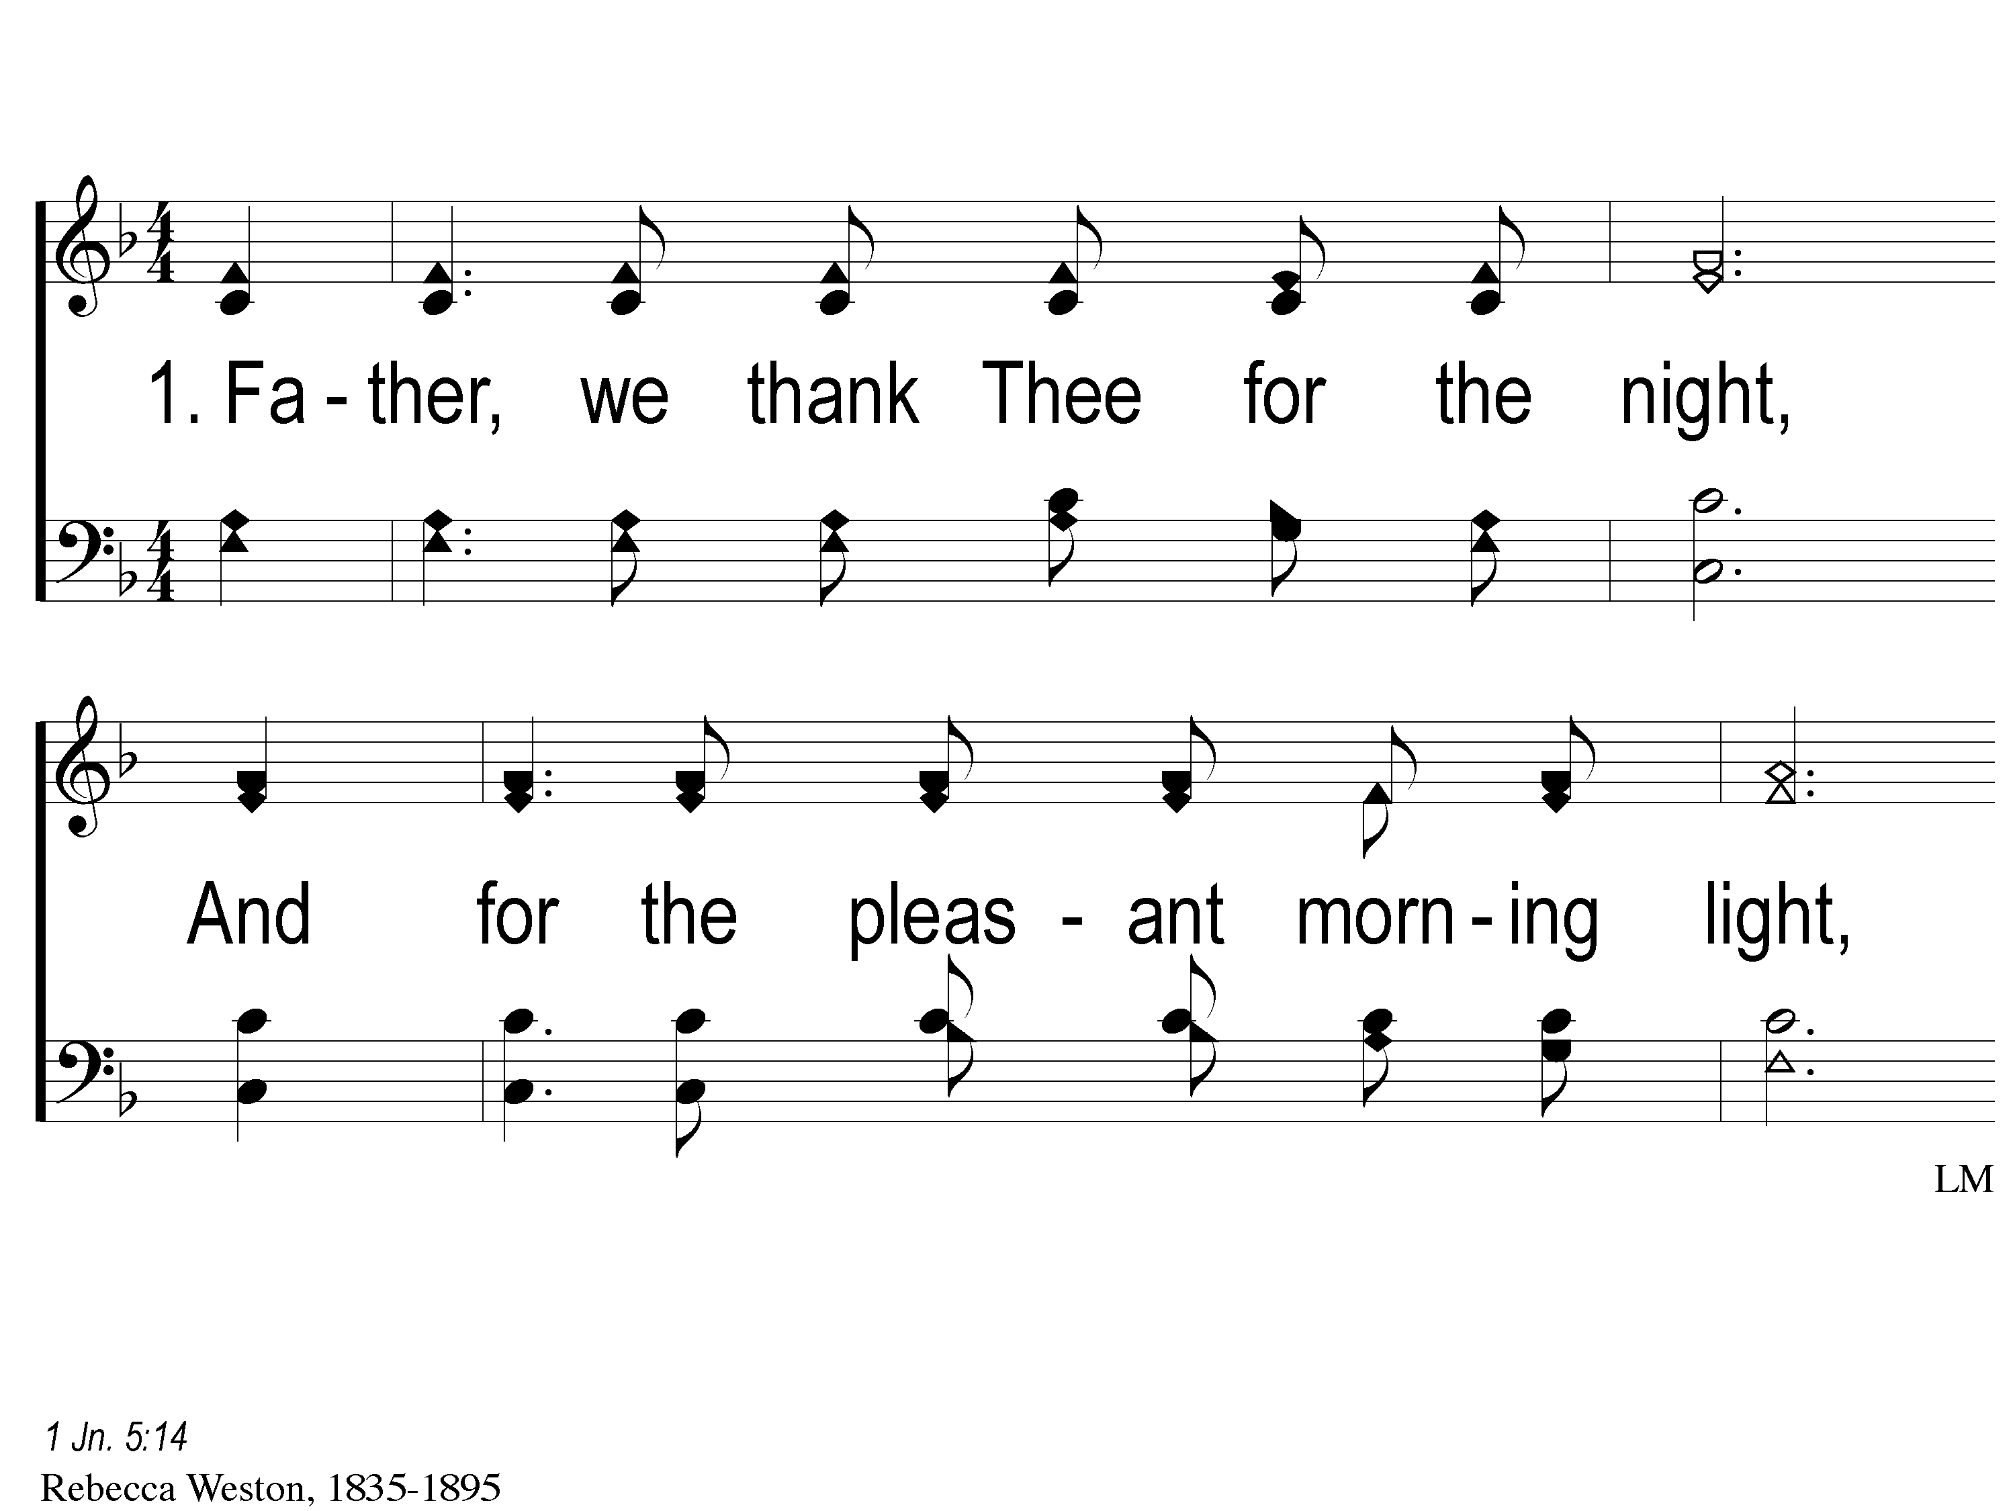
1-1 Father We Thank Thee
Father We Thank Thee
104
ePraise Hymn Presentation © 2005 Taylor Publications
ePraise Hymn Presentation © 2005 Taylor Publications

Slide 2
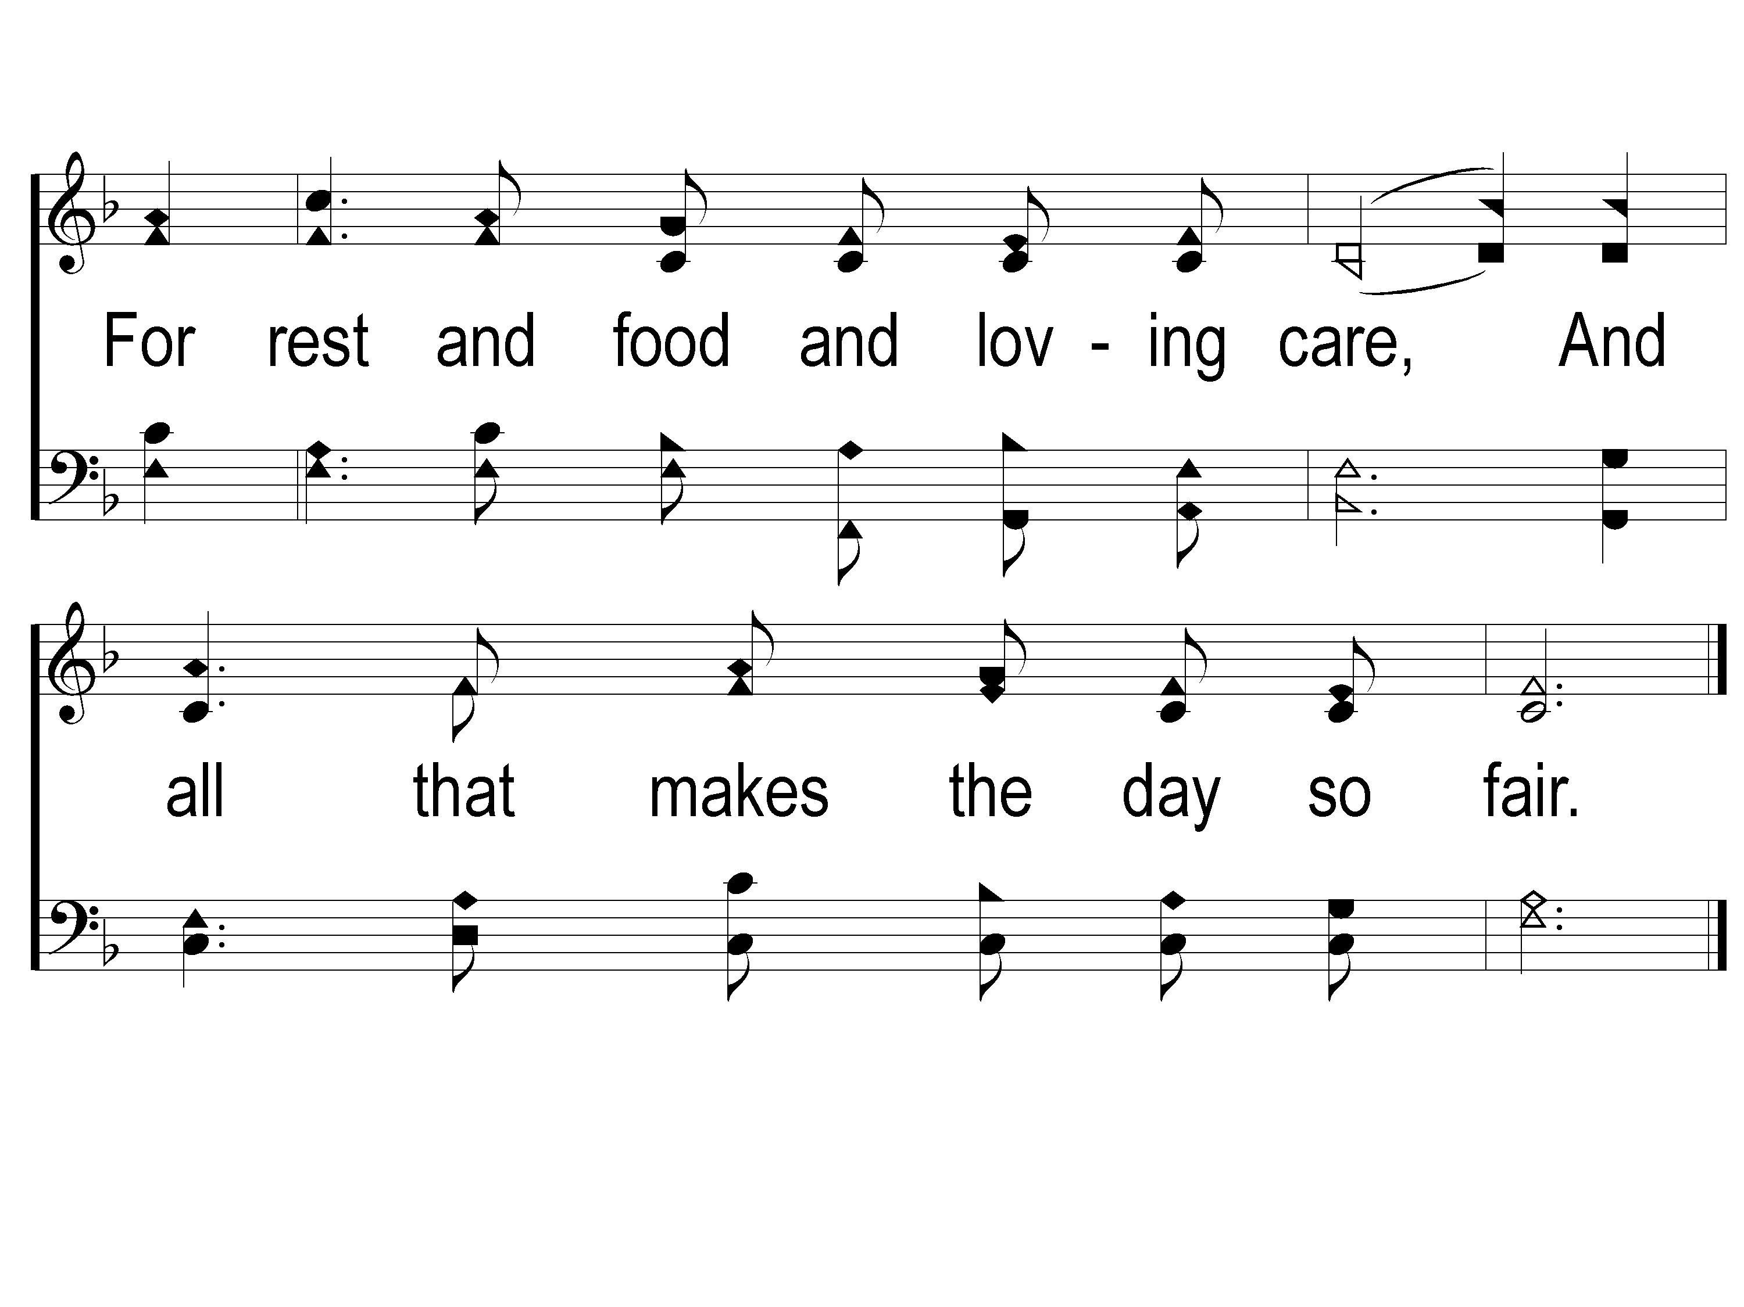
1-2 Father We Thank Thee
Father We Thank Thee
104
ePraise Hymn Presentation © 2005 Taylor Publications
ePraise Hymn Presentation © 2005 Taylor Publications

Slide 3
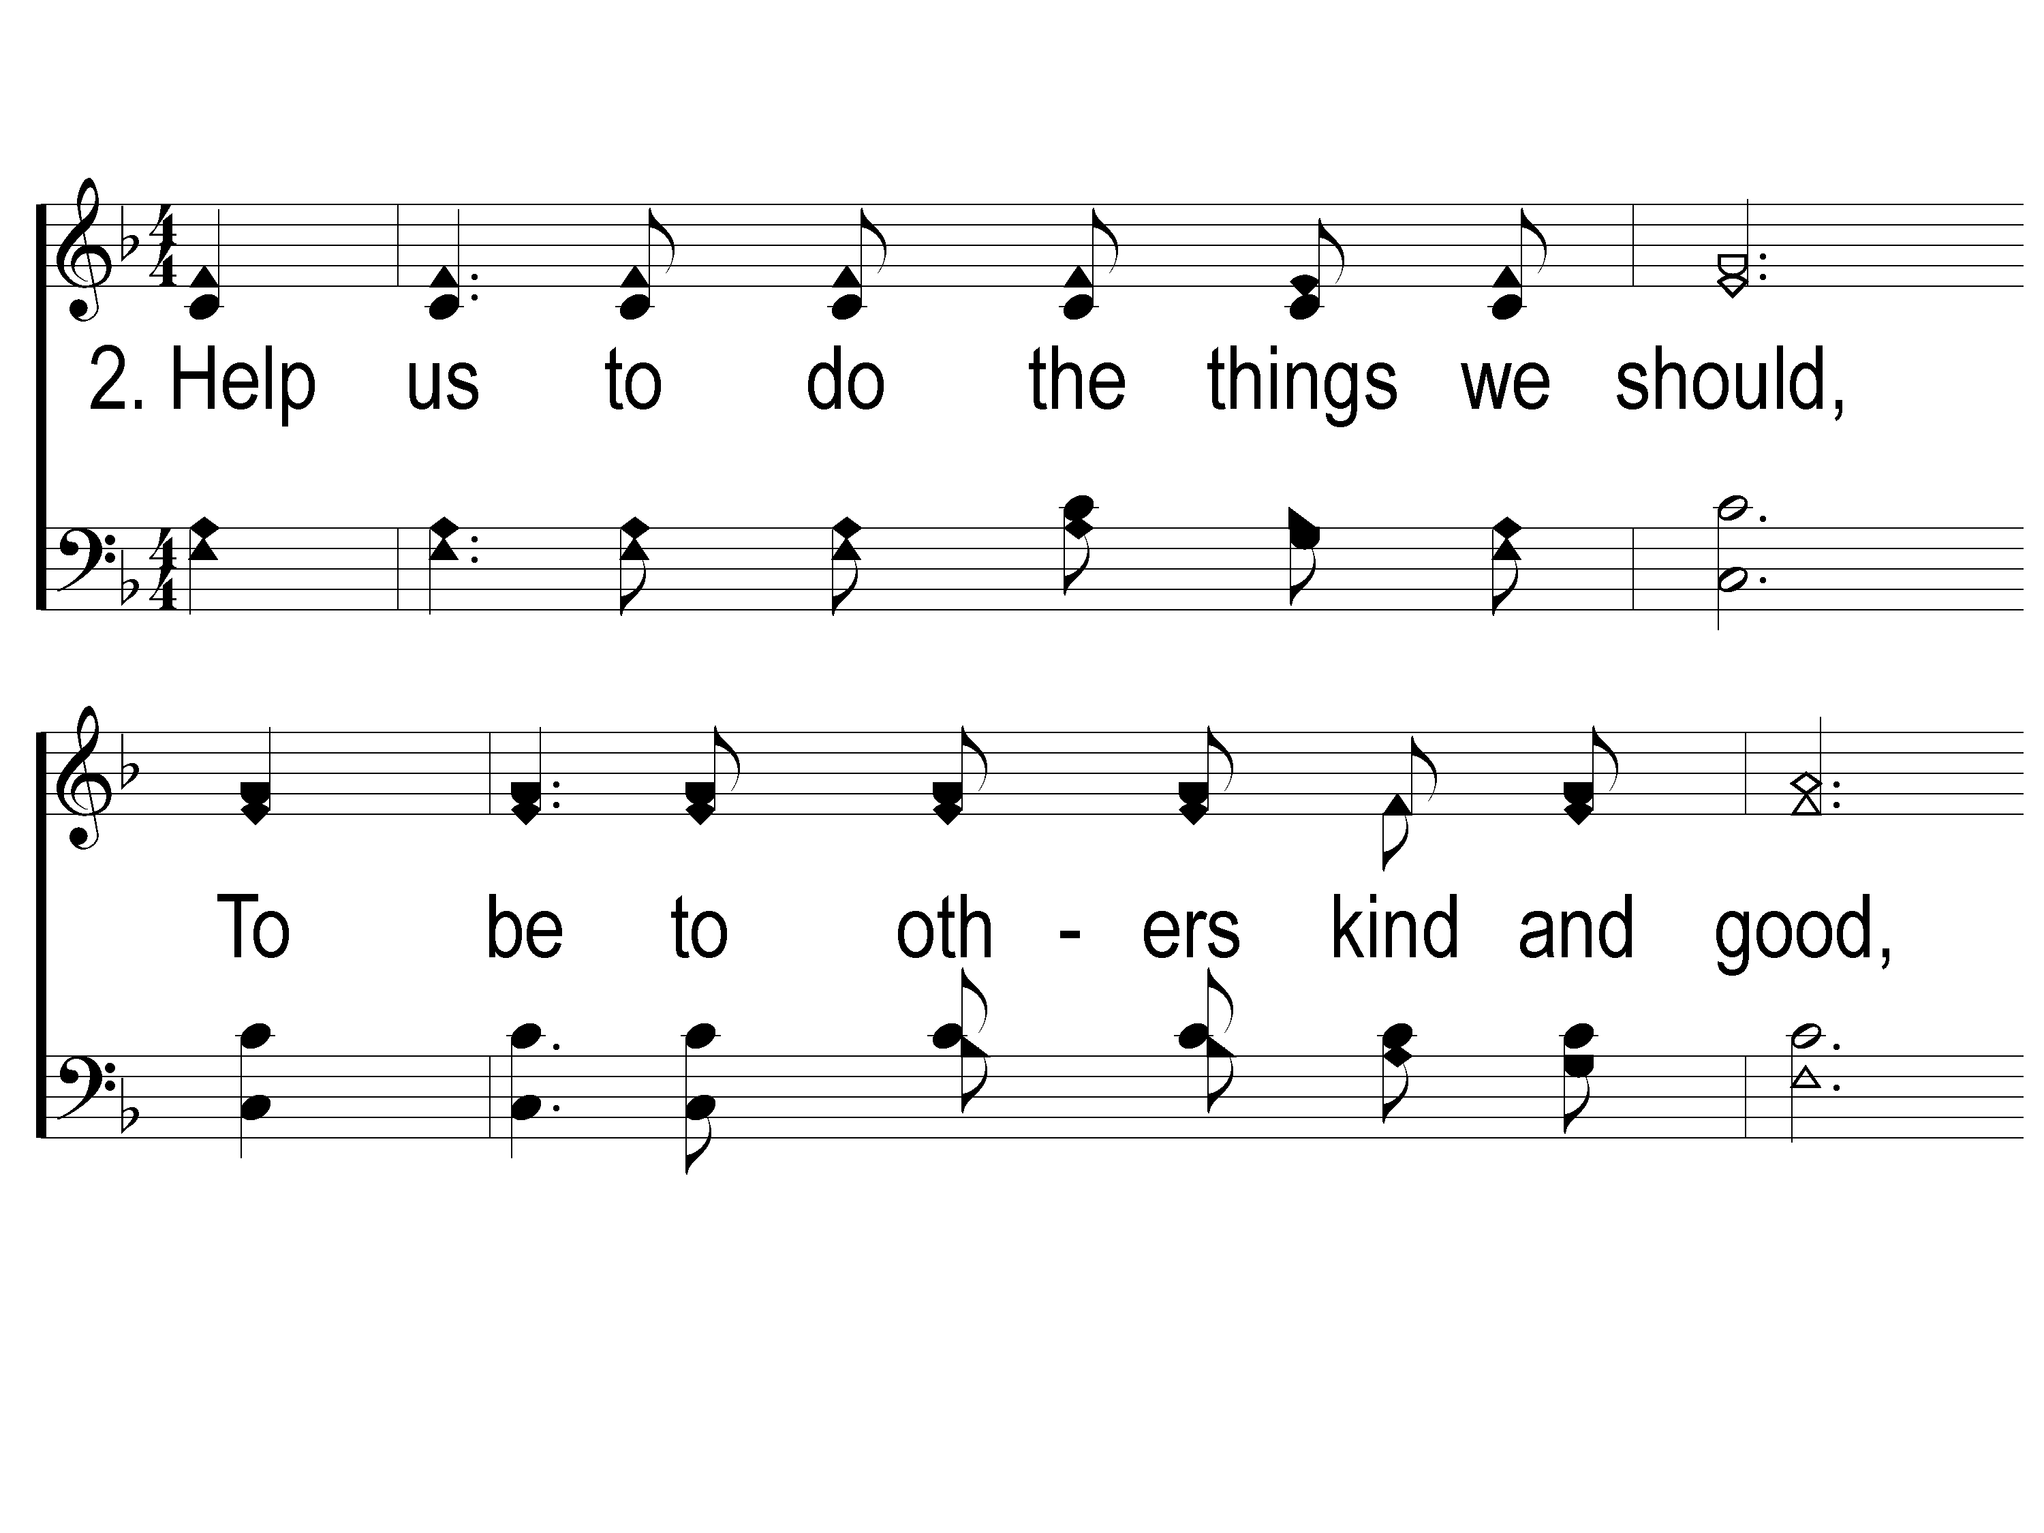
2-1 Father We Thank Thee
Father We Thank Thee
104
ePraise Hymn Presentation © 2005 Taylor Publications
ePraise Hymn Presentation © 2005 Taylor Publications

Slide 4
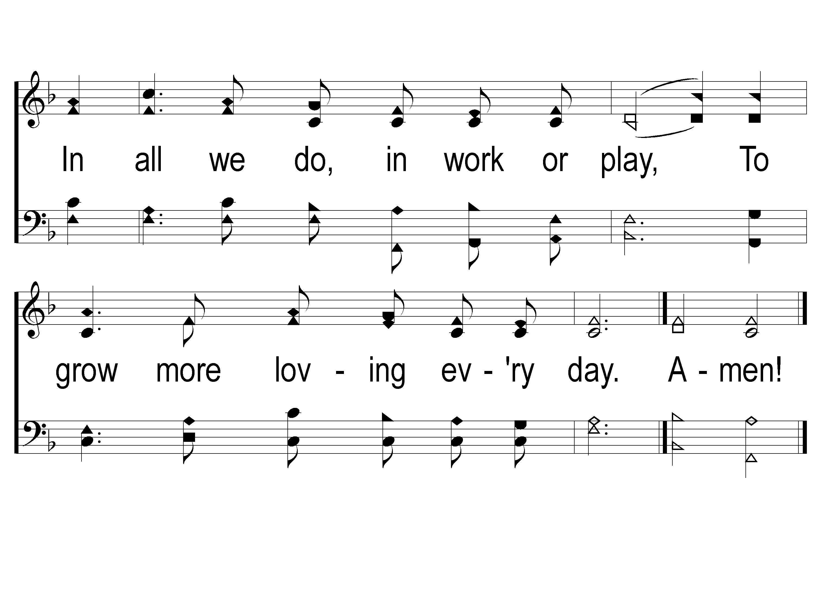
2-2 Father We Thank Thee
Father We Thank Thee
104
ePraise Hymn Presentation © 2005 Taylor Publications
ePraise Hymn Presentation © 2005 Taylor Publications

